Slide 1
Vehicular Network Analysis Using Probabilistic Model Checking
Jonathan Lo, Tommaso Peletta
3 Juin 2021

Slide 2
Goal of the project
Using probabilistic model checker to analyse vehicular network

Slide 3





Probabilistic Model Checker
Model
Model Checker
Result
$$φ$$
Properties

Slide 4
Probabilistic Model Checker
Prism
GreatSPN
Programming language
Analyze : nondeterministic and real-time characteristics
Free and open source
Modelling, validation and performance evaluation
Generalized Stochastic Petri Nets with extensions
User friendly GUI
Documentation out of date

Slide 5
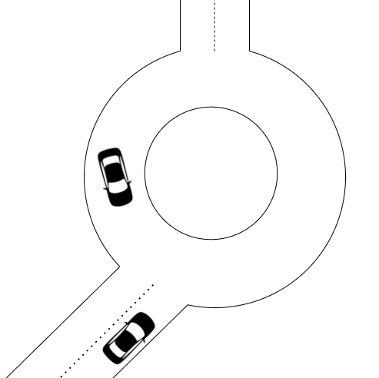
Roundabout Insertion Analysis
Model
Single lane roundabout
Mix of driver and autonomous vehicle
Non-deterministic initial state and behaviour

Slide 6
Roundabout Insertion Analysis
Properties
Collision probability
Overall braking
Time before insertion

Slide 7





Stochastic Cellular Automata
Vehicle H simplification
Vehicle A simplification
Vehicle H size
Intersection
Vehicle A size

Slide 8

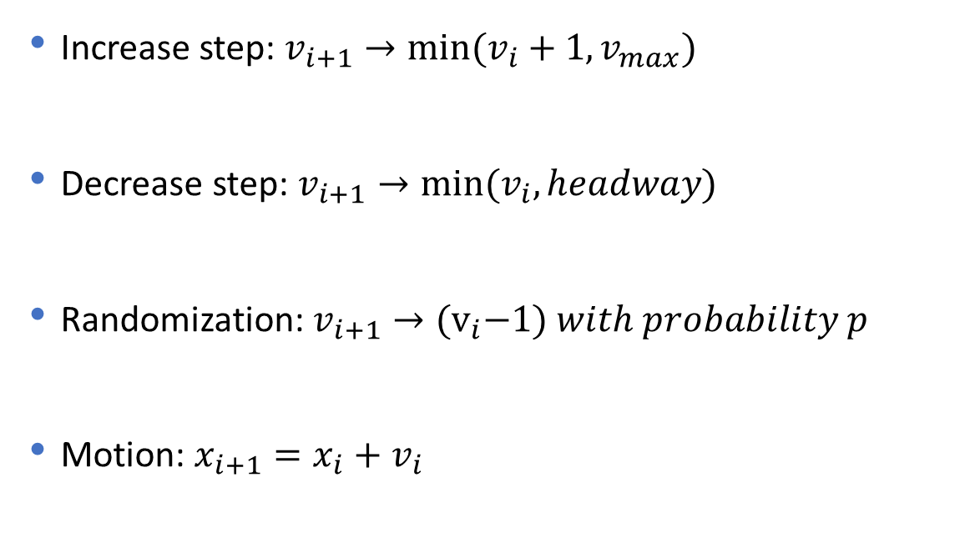
Nagel-Schreckenberg Model
Increase step: $v_{i+1}→min⁡(v_{i}+1, v_{max})$
Decrease step: $v_{i+1}→min⁡(v_{i}, headway)$
Randomization: $v_{i+1}→{(v}_{i}−1) with probability p$
Motion: $x_{i+1}=x_{i}+v_{i}$
$$⁡$$

Slide 9
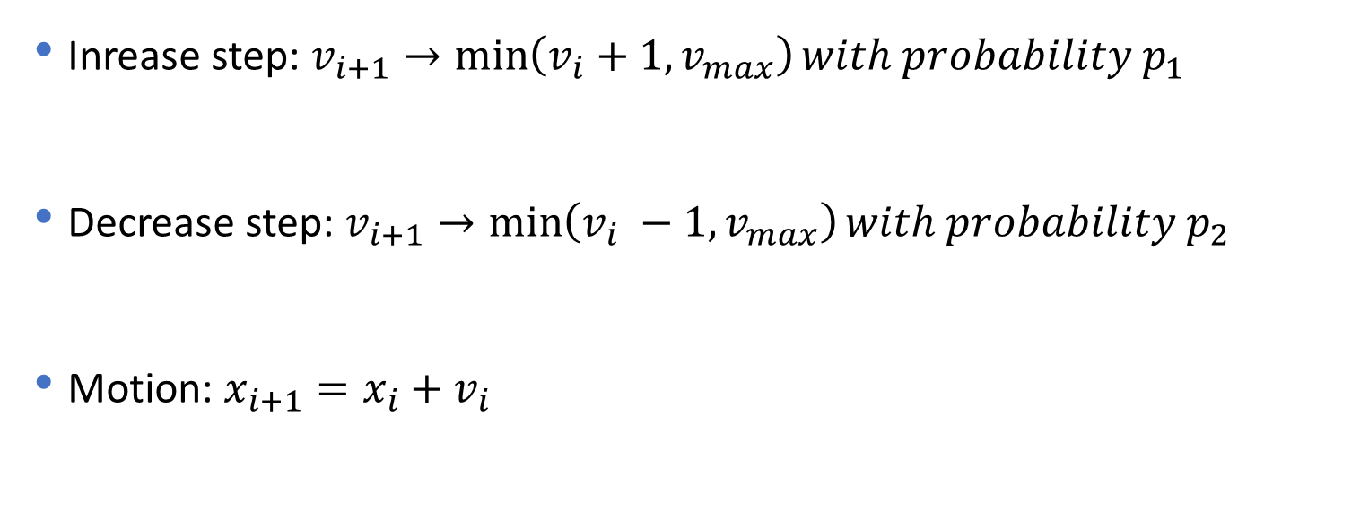
Nagel-Schreckenberg Modified
Vehicle H
Inrease step: $v_{i+1}→\min\left(v_{i}+1, v_{max}\right)with probability p_{1}$
Decrease step: $v_{i+1}→\min\left(v_{i} −1, v_{max}\right)with probability p_{2}$
Motion: $x_{i+1}=x_{i}+v_{i}$
$$⁡$$

Slide 10
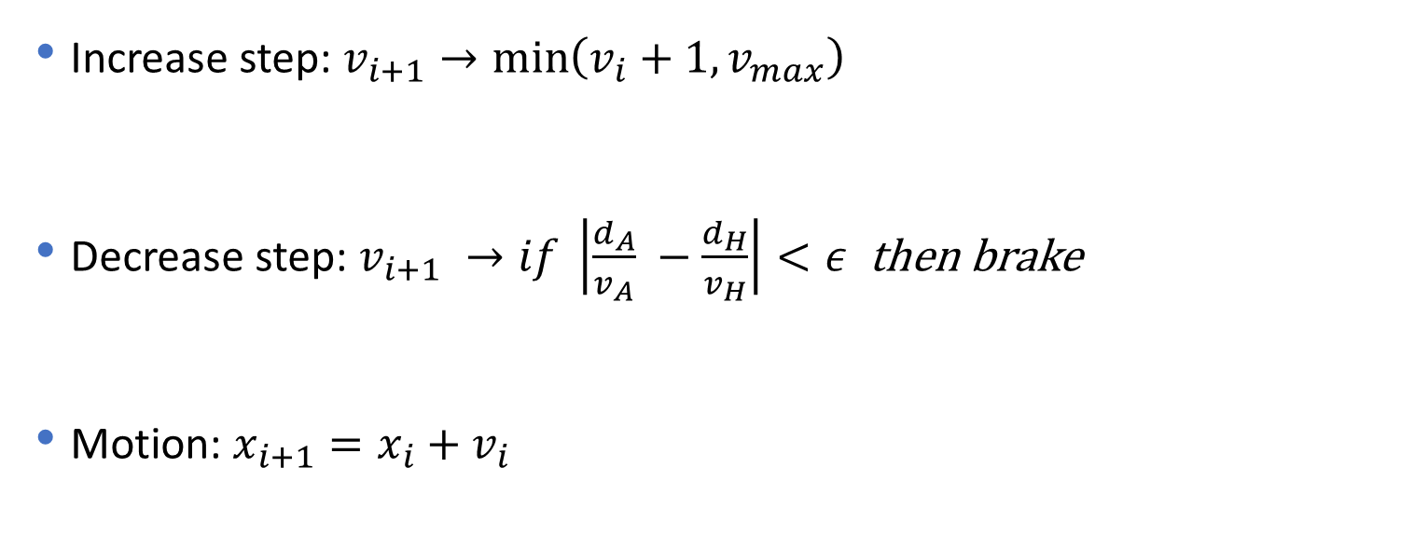
Nagel-Schreckenberg Modified
Vehicle A
Increase step: $v_{i+1}→\min\left(v_{i}+1, v_{max}\right)$
Decrease step: $v_{i+1} →if \left|\frac{d_{A}}{v_{A}} −\frac{d_{H}}{v_{H}}\right|<ε$ then brake
Motion: $x_{i+1}=x_{i}+v_{i}$
$$⁡$$

Slide 11
Roundabout Insertion Analysis
Problems
Not suited for a probabilistic model checker
Arificial parameters
Modelling problem

Slide 12
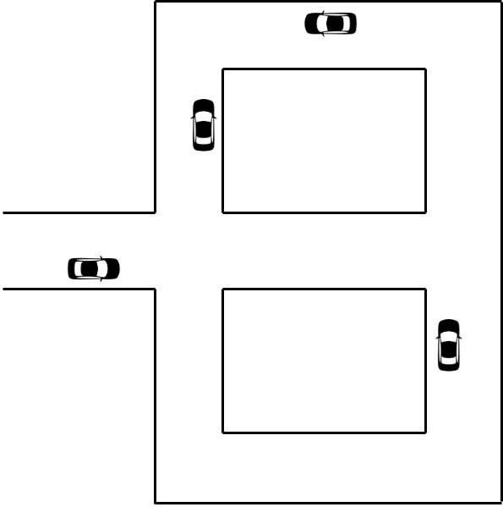
Road topology
Goal
Analyze vehicular traffic
Overloaded road
Find solution to improve traffic flow

Slide 13
Road topology
Model
Portion of a roadmap
Initial configuration predetermined
Road divided in segments with different travel time
Same probability

Slide 14
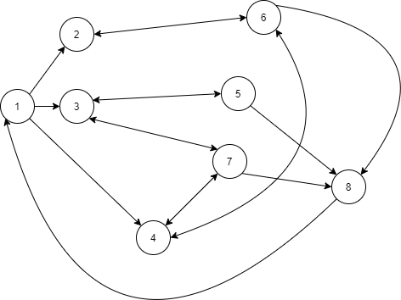
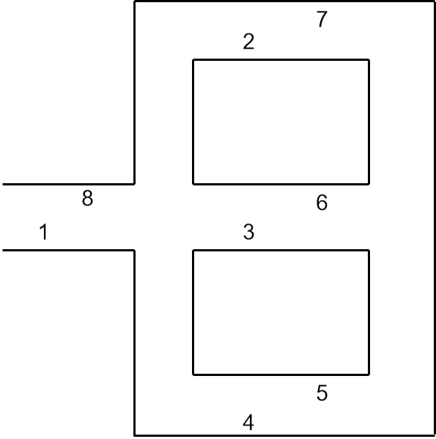
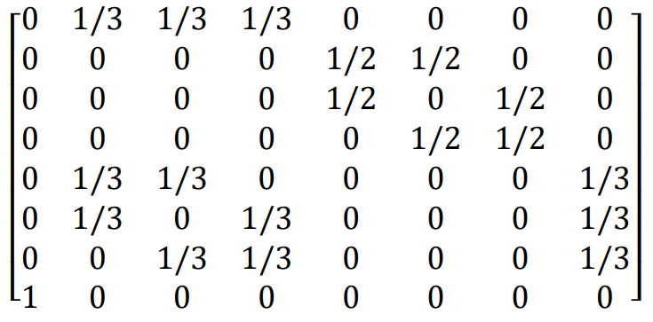
Markov Model

Slide 15
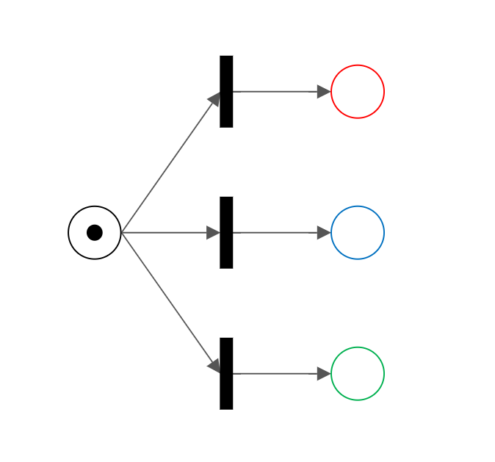
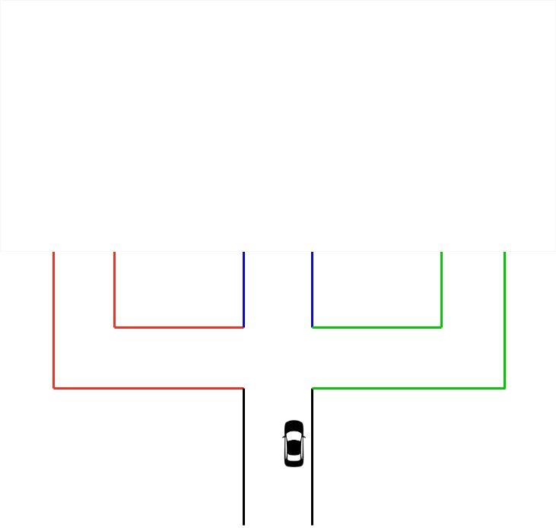
Petri Net
1/3
1/3
1/3

Slide 16
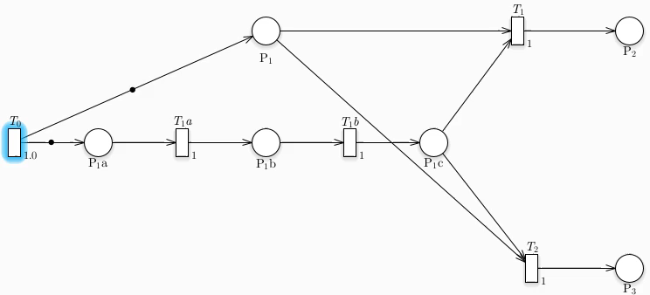
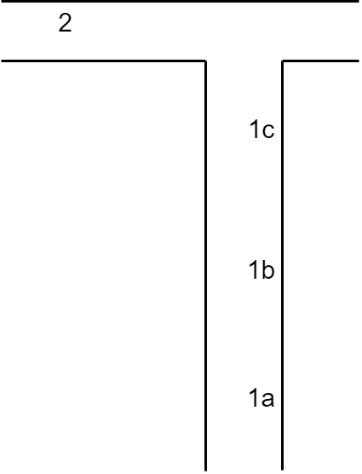
Petri Net : Distance
3

Slide 17
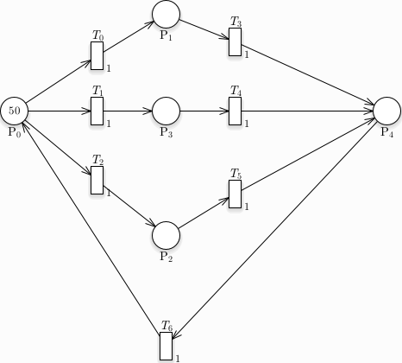
Rate : problem

Slide 18
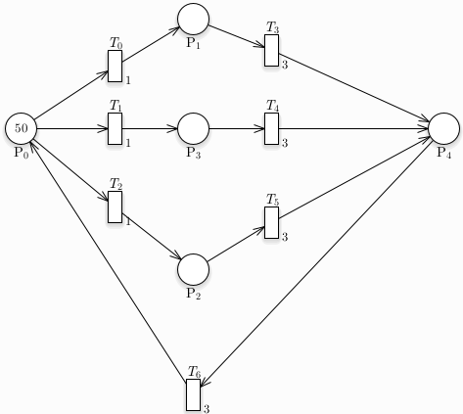
Transition’s Rates

Slide 19
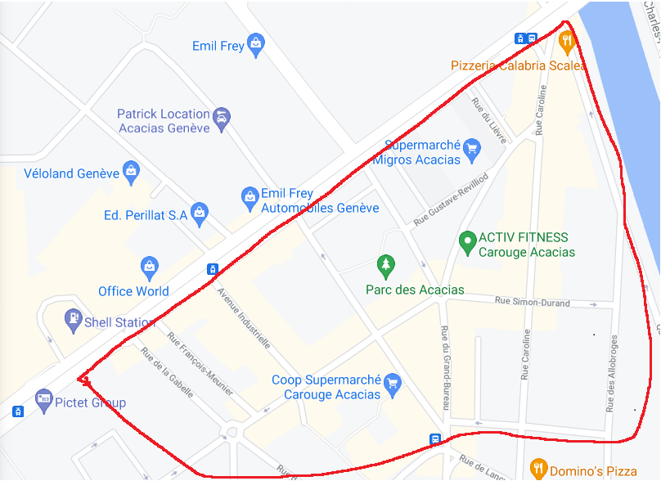
Map
38
37
25
36
11
31
33
30
35
26
9
10
32
24
23
34
21
22
29
28
8
7
15
4
16
20
3
6
12
5
14
17
13
19
0
2
18
1

Slide 20
Vehicule Insertion
Deterministic
Non-Deterministic
Vehicule inserted in the same road on opposite direction
Vehicule inserted randomly in one entry point of the model

Slide 21
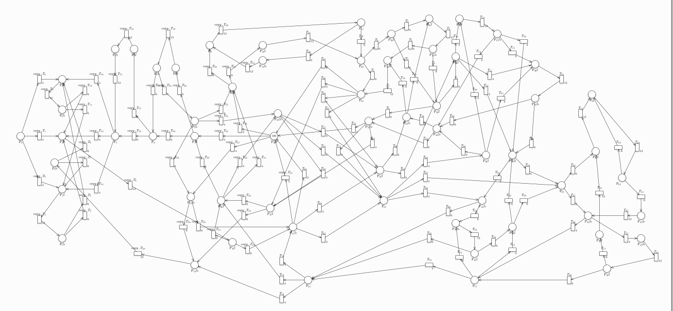
Deterministic Insertion Model

Slide 22
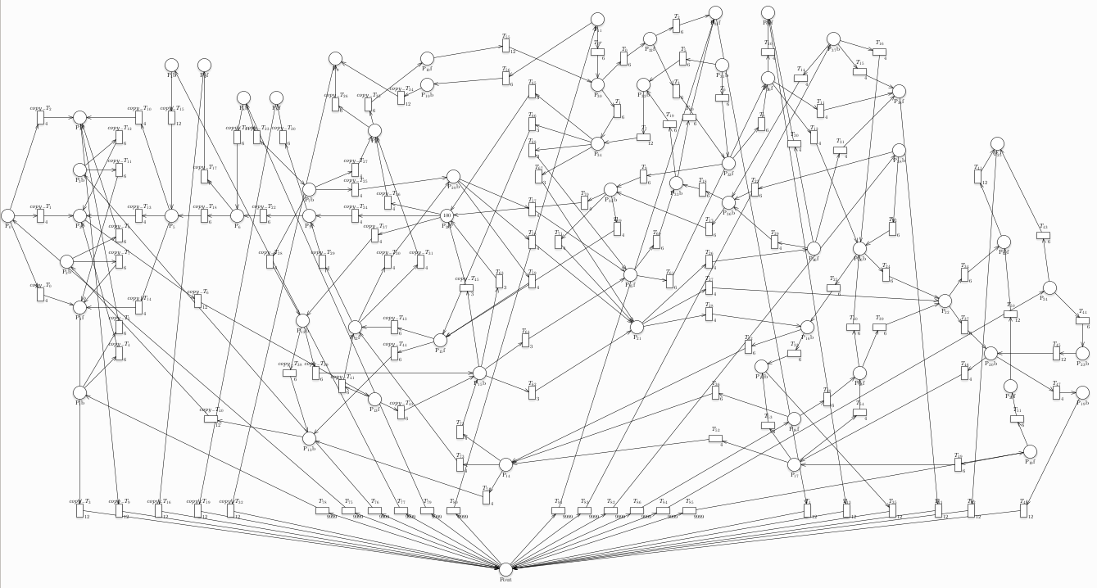
Non-Deterministic Insertion Model

Slide 23
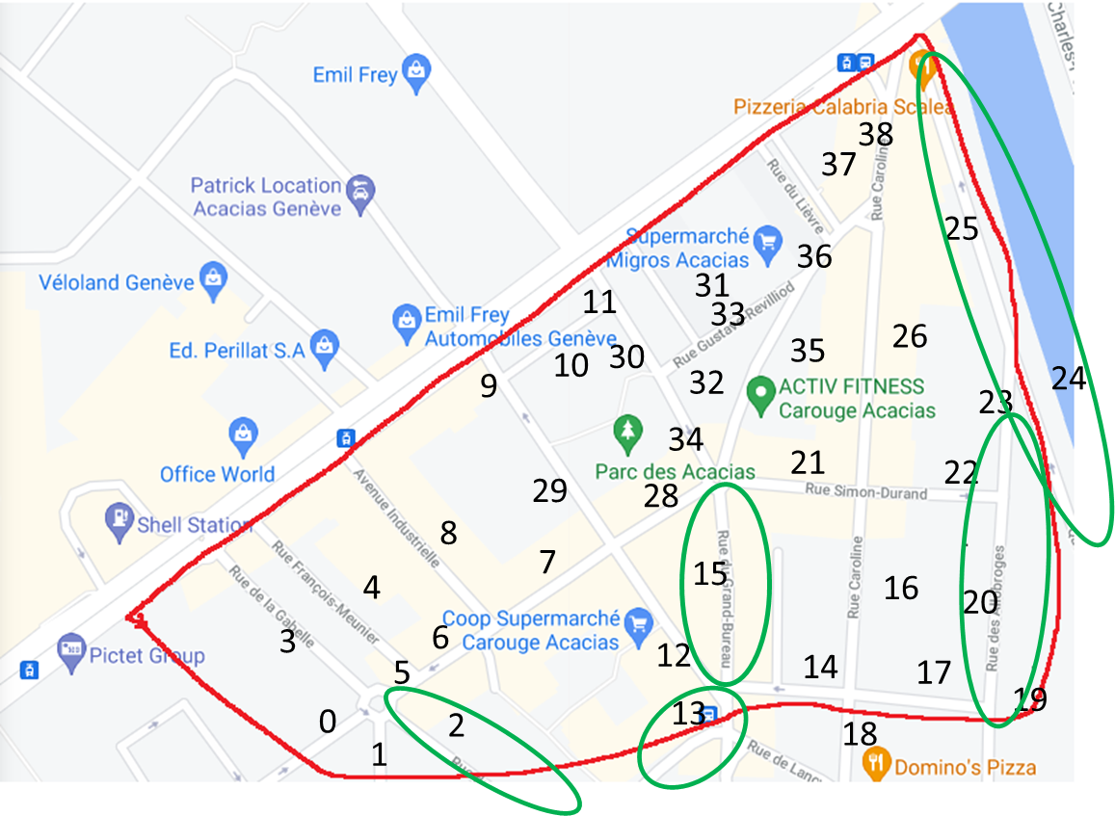
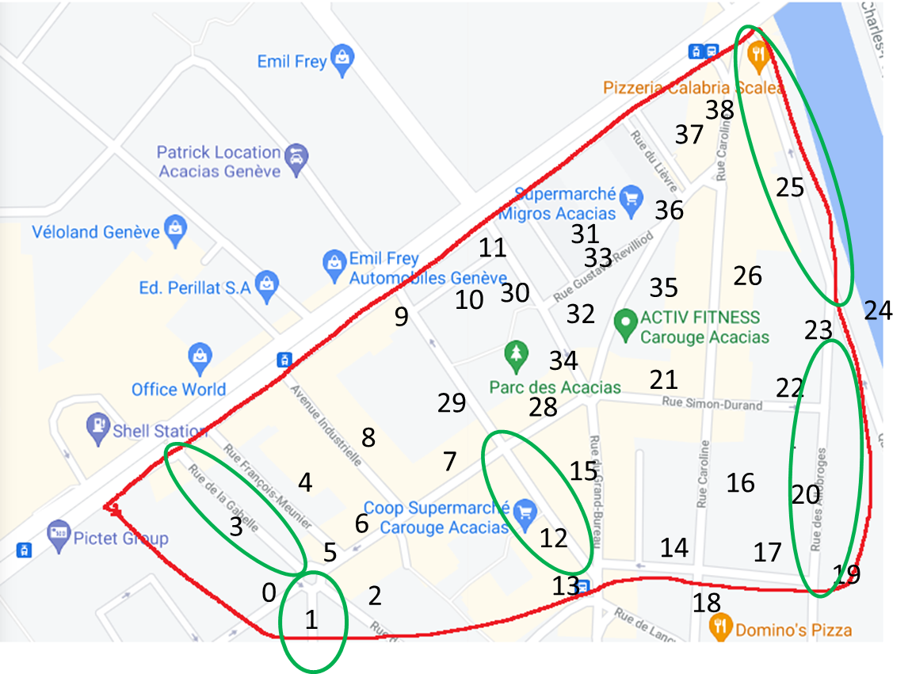
Map : Overload
Deterministic
Non-Deterministic

Slide 24
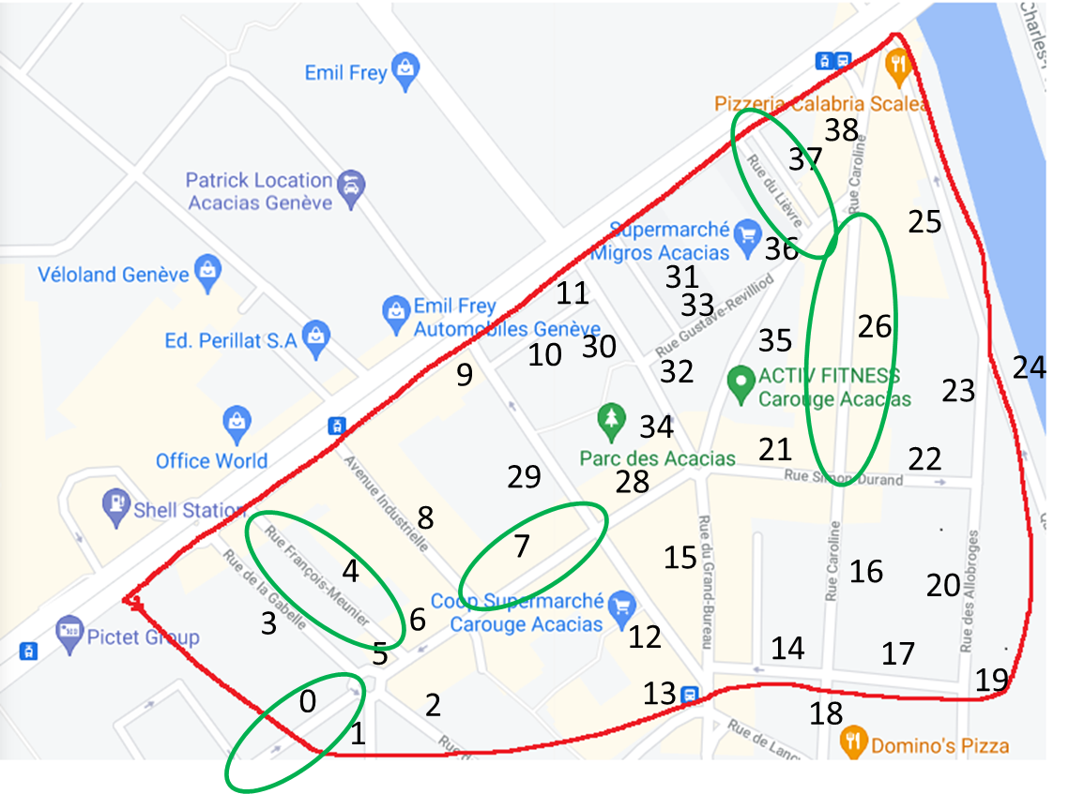
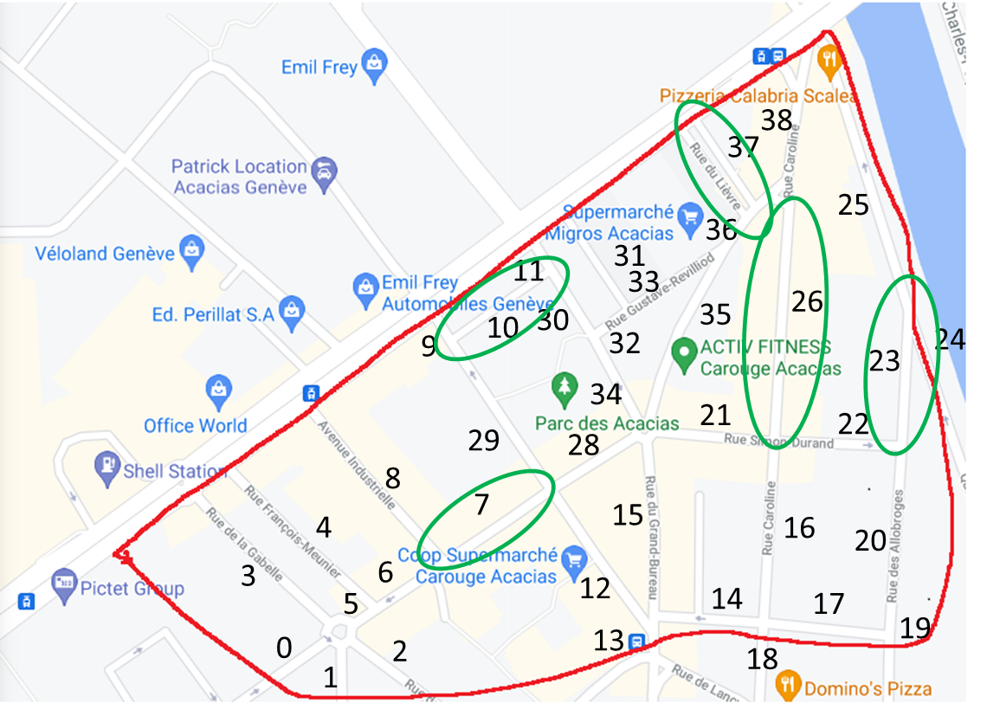
Map : Low traffic
Deterministic
Non-Deterministic

Slide 25
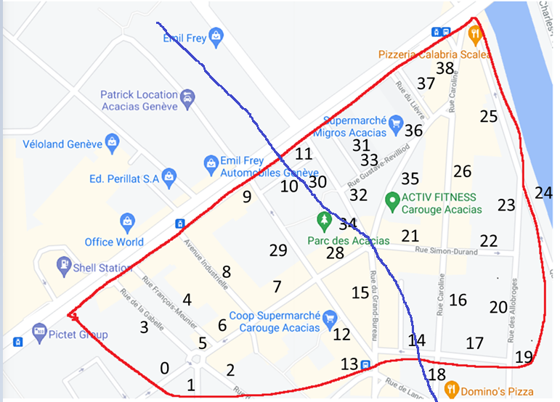
Local analysis
Model complexity
Time complexity
Evaluate random reinsertion

Slide 26
Local analysis : left part
Average error : 0.15
Total error : 4.373
Average connector error : 0.358
Total connector error : 2.51

Slide 27
Local analysis : right part
Average error : 0.088
Total error : 3.088
Average connector error : 0.081
Total connector error : 0.916

Slide 28
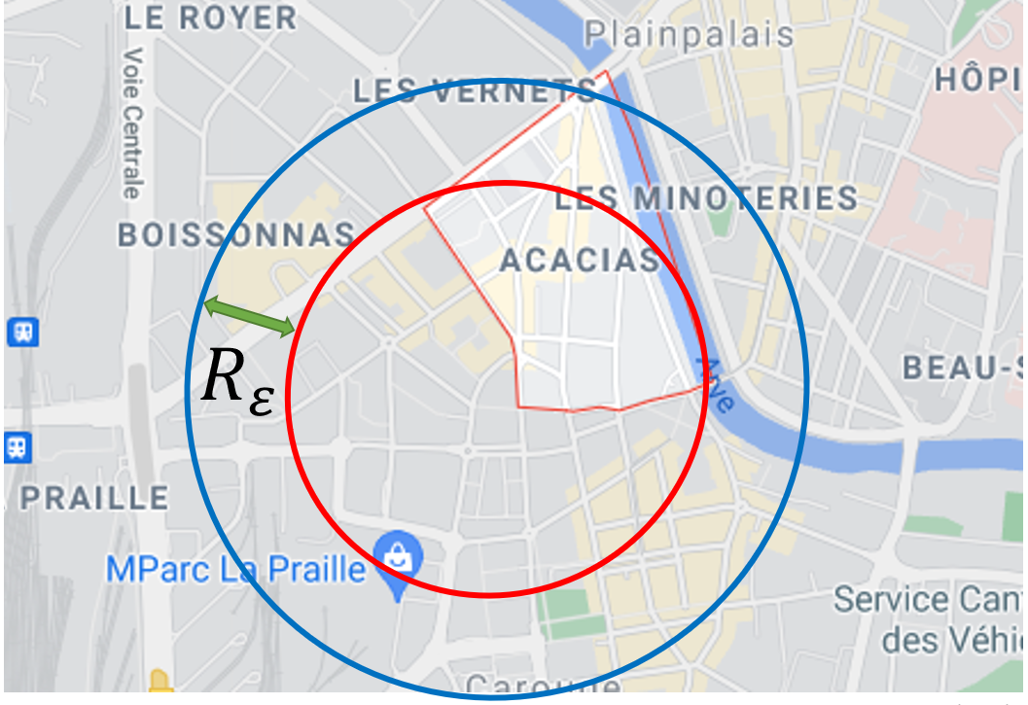
Mitigate border error

Slide 29
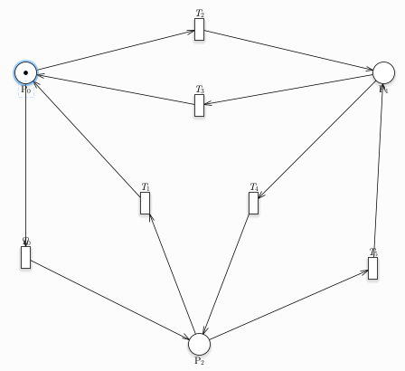
Complexity Analysis : Model
Complete Petri Nets
5000 iterations for each batch
1% error
Multiple executions with random seeds

Slide 30
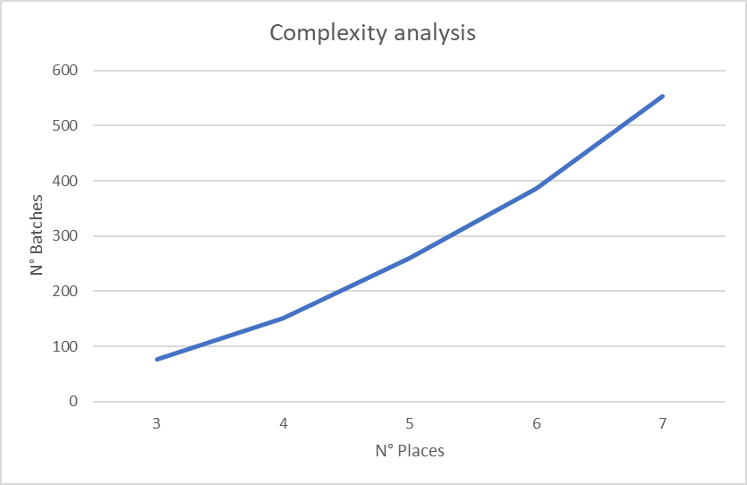
Complexity Analysis : Results

Slide 31
Further Work
Compare results with real data
Solve traffic overload
Better parameter estimation for local analysis
Add notion of travel time

Slide 32
Conclusion
Probabilistic model checking is not suited for all problems
GreatSPN is a powerfull tool for non-deterministic analysis
Better documantion would allow better analysis
Petri nets seems a useful tool for vehicular traffic analysis but a lot of research still need to be done on this topic.

Slide 33
Github
https://github.com/TommasoPeletta/Probabilistic-Model-Checking-with-PRISM

Slide 34
Vehicular Network Analysis Using Probabilistic Model Checking
Jonathan Lo, Tommaso Peletta
3 Juin 2021

